Slide 1

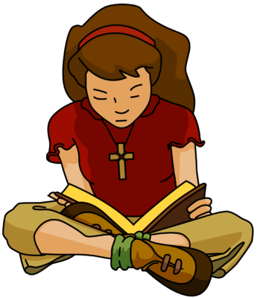

The B-I-B-L-E
The B-I-B-L-E Yes, that's the book for me I stand alone on the
Word of God The B-I-B-L-E

Slide 2
BIBLE: stand alone:
Word :

